Slide 1
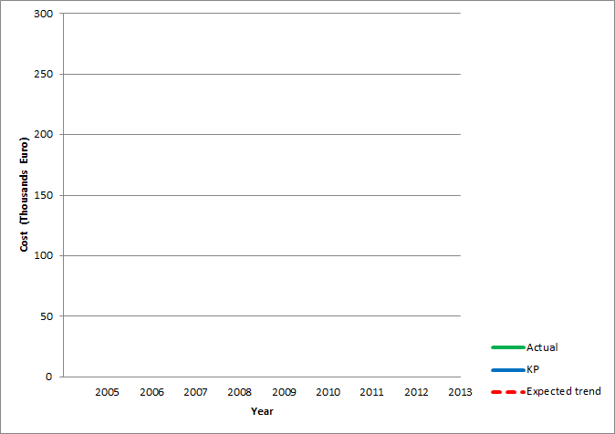
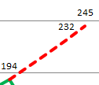
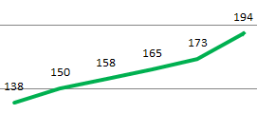
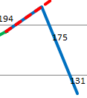



OGSAM: How IT Saving project strategy works:
How was this strategy was designed to make it happen?
1. Serious test plan and decreasing number of system errors and requests by 42%
2. Using market and economy factors (Threat→ Opportunity)
79% = 194 TE
cost saving per year vs. expected
3. Training our staff
4. Decreasing dependency using systematic solution for data replication, data modifications, …
61% = 80 TE
cost saving per year
vs. KP
5. High performance team development
In addition to significant service level improvement, the following services/ savings were covered in last two years:
1. Part of enhancement and closing support were included in new contract!
2. Number of local support FTE decreased from 18 to 6 before 2010 VS after 2010
Cost saving
Slide <number>

Slide 2
SAP Iran - project plan overview
2011 |  |  |  |  |  | 2012
07 | 08 | 09 | 10 | 11 | 12 | 01 | 02 | 03 | 04 | 05 | 06 | 07 | 08 | 09 | 10 | 11 | 12 | 01
FD preparation UW
Template setting
Development system Available
Convert FD
to system
I-Test prep
Consolidation system Readiness
Productive system Readiness
Cut Over activities
Horizon
orientation
FD preparation UA
Template setting
Unit
Test
I-Test
go
Live
Kick-off
Kickoff WS &
UA to UW Check
Plant concept UA &
detailed GAP analysis
Document layout Farsi
WS
FO
WS
WS
GAP
approval
FD preparation
Approved GAPs
Convert GAP
FD to system
Unit
Test
Go- live
Support
SAP
Basics
MD Orientation
KU training on
template processes
KU training with
own settings
End user
training preparation
End user training
sessions (template)
Activity Types
KU GAP
training
End user training
sessions (GAPs)
Master Data
IDH/Master Data WS / training
MEA Template Setup
Master Data filtration
IDH Master data
preparation
IDH
Distr.
C-system
upload
P-system
upload
Training
Others
Authorization
Orientation
Preparation local MD files for Q
Catch-up data gathering
Double maintenance
Basis Support
Authorization
Training
Update local MD files for P
GAP setup
Users
Profiles
on C
Authorization Realization
Users
Profiles
on P
Authorization definition
Milestones
Preparation
Analyze & design
Build
Test
Deploy
SAP Plan
Slide <number>

